Slide 1
Chapter II System Development Life Cycle
Meas Vandeth

Slide 2
Objectives:
ណែនាំអោយស្គាល់ផ្លូវត្រូវដើរដើម្បី អភិវឌ្ឍ ប្រព័ន្ធព័ន្ធព័ត៌មាន ចំនុចសិក្សា
Phases(Stages) for Develop System
Tasks in each phases.
Involver

Slide 3
1. What is SDLC ?
SDLC is a process for planning, creating, testing, and deploying and maintenance an Information System
Standard SDLC is divided in stages
System Planning (Preliminary Investigation)
System Analysis
System Design
System Implementation
System Supports (System Maintenance)
Some methods are 6 or 7.

Slide 4
Phase 2. Analysis
Conduct preliminary investigation
Perform detailed analysis activities:
Study current system
Determine user requirements
Data Model process model..
……
Phase 1. Planning
Phase 3. Design
Review project requests
Prioritize project requests
Allocate resources
Identify project development team
Acquire hardware and software, if necessary
Develop details of system
……
Phase 5. Support
Phase 4. Implementation
Conduct post-implementation system review
Identify errors and enhancements
Monitor system performance
Develop programs, if necessary
Install and test new system
Train users
Convert to new system

Slide 5
2. System Planning
This is the first phase in the systems development process. It identifies whether or not there is the need for a new system to achieve a business’s strategic objectives.
This is a preliminary plan (or a feasibility study) for a company’s business initiative to acquire the resources to build on an infrastructure to modify or improve a service. The company might be trying to meet or exceed expectations for their employees, customers and stakeholders too. The purpose of this step is to find out the scope of the problem and determine solution architecture. Resources, costs, time, benefits and other items should be considered at this stage.
Define Information System Architecture.
Who responsible? Top management including IT Manager.

Slide 6
System Planning’s Task
Define problem. What is problem? ជាឧបស័គ្គ​​ ជាការខាតបង់(ចំនាយ ប្រតិបត្តការខ្ពស់) ដល់ការអភិ…..
Define opportunities. Opportunity to find solutions for reducing or removing problems.
Define project scope: កំណត់ ទំហ៊ំរបស់គំរោង មាន ប៉ុន្មាន មុខងាររបស់ អាជីកម្មត្រូវ Automat, Automate កំរិតណា Online/Offline ,….
Estimate requirements for opportunities: ប៉ាន់ប្រមាណមើលតំរួវការ​សំរាប់ ដំណោះស្រាយ។ អ្នកអាច​ អញ្ជើញក្រុមហ៊ុនផ្គត់ផ្គង់ គេសិក្សានិងចេញ​QUOTATION
Feasibility study and select best solution សិក្សាលទ្ធភាពអាចធ្វើទៅបាន ដើម្បី ថ្លឺង រួចសម្រេចជ្រើសរើស យកជំរើសដែលប្រសើបំផុតសំរាប់ក្រុមហ៊ុន
Documentation.រៀបចំឯកសារផ្លូវការពីគំរោង

Slide 7
System Feasibility Study
សិក្សាលទ្ធភាពដែលអាចធ្វើទៅបាន(Feasibility study) គេត្រូវសិក្សាលើចំនុចៈ
Operational Feasibility: កំណត់ ការងារអទិភាព​និង កំរិត ស្វ៏័យប្រវត្តរបស់
ប្រព័ន្ធ។
Technology Feasibility: សិក្សា Hardware software network software
architecture ,… ដែលអាចប្រើប្រាស់ក្នុងការសង់ប្រព័ន្ធ។
Economic Feasibility: សិក្សាលើការចំណាយ សង់ Maintenance រួមទាំង
ផលចំណេញ ប្រយោជន៍របស់ប្រព័ន្ធ។

Slide 8
Reasons for new Information System
Improving service and create more services
Better performance
More Information and stronger control
More Security and storages
Reduce Operation Cost

Slide 9
3. System Analysis Phase
Is the second phase of SDLC that analyst study details of existing system to find requirements for design and developing a new better system.
ចំនាំ: ដំណាក់វិភាគប្រព័ន្ធគឺមិនមែនរកដំណោះស្រាយទេ គឺរកតំរូវការ (គោល
នយោបាយ និតិវិធី ទំរង់ផ្សេងៗ ......​ដើម្បីរៀបចំដំណោះស្រាយអោយឆ្លើយតបបានតាម
តំរូវការរបស់ អាជីវកម្មដែលបានរកឃើញ។
The three primary activities involved in the analysis phase are as follows:
Gathering business requirements
Creating process diagrams
Creating Data Modelling diagram

Slide 10
Gathering business requirement/Fact finding/ Requirement modelling
ការប្រម៉ូលពត៌មាន និង ទិន្នន័យជាតំរូវការចាំបាច់សំរាប់អភិវឌ្ឍន៍ប្រព័ន្ធតាមរយៈ
សម្ភាស
ការអង្កេត
ការប្រម៉ូលឯកសារគំរូ
ការ Survey
តំរូវការមានពីរស្រទាប់គឺៈ
តំរូវការរបស់ស្ថាប័ន ក្រុមហ៊ុន?អ្វីដែលគេត្រូវការ ប្រព័ន្ធអោយជួយធ្វើ
តំរូវការរបស់ System Developer? តំរូវការរបស់ក្រុមបច្ចេកទេសត្រូវដឹងពីរ
អាជីវកម្មដើម្បីកសាងប្រព័ន្ធអោយឆ្លើយតបបាន តំរូវការខាងលើ។

Slide 11
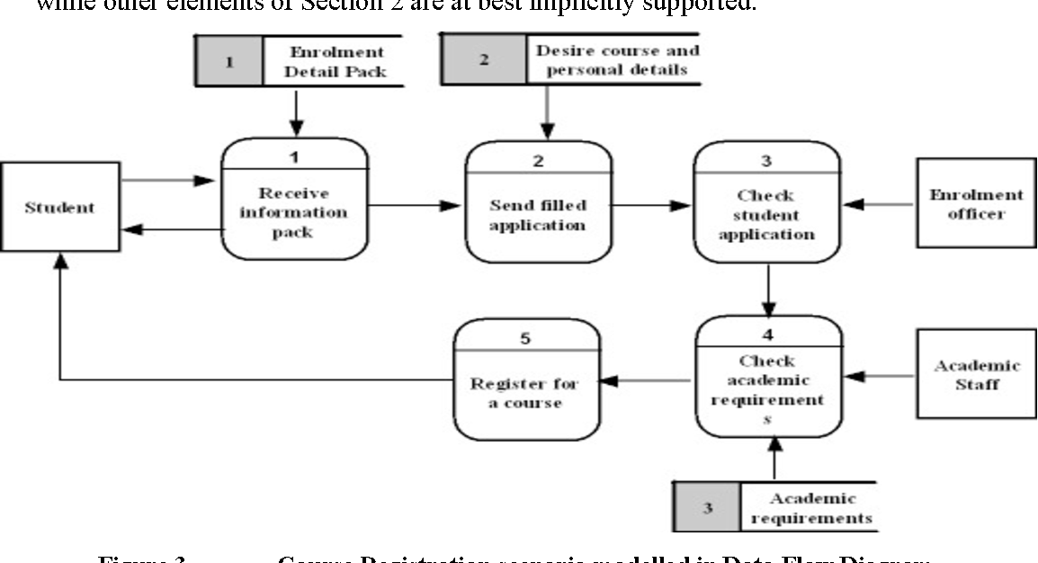
Process Modelling
ការសិក្សារកមុខងារ(ការងារ)​ របស់អាជីវកម្មដែលត្រូវ អនុវត្តដោយប្រព័ន្ធ​កុំព្យូរទ័រ
ដោយភ្ជាប់ជាមួយនូវ គោលការណ៍ រូបមន្ត លក្ខខ័ណ្ឌ និងរកអោយឃើញនិតិវិធី(លំ
ហូរការងារ)ដែលប្រព័ន្ធត្រូវប្រតិបត្តតាម។

Slide 12
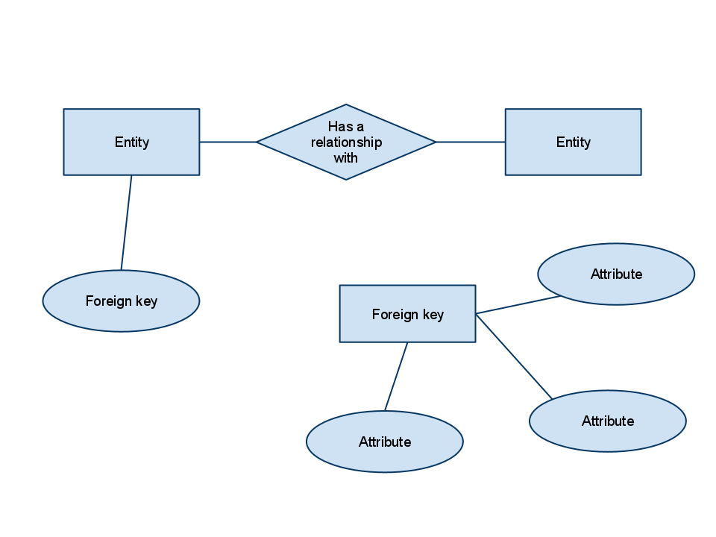
Data Modelling
ការសិក្សារកទិន្នចាំបាច់ ដោយផ្តោតលើ គោលដៅដែលជា ធនធាន ប្រតិបត្តការ
ដែលក្រុមហ៊ុន ត្រូវការគ្រប់គ្រង​ដោយភ្ជាប់ជាមួយ ទិន្នន័យពិពណ៌នា រួមទាំងទំរង់
ផ្សេងៗដែលគេប្រើប្រាស់។

Slide 13
4. System Design Phase
ជាដំណាក់កាលទីបី នៃSDLC ដែល System Designer (Analyst) បំលែង Requirements
ជាទំរង់នៃដំណោះស្រោយដែលអាច អនុវត្តន៍ដោយកុំព្យូទ័កើត។(Translate
requirements into technical solution format or build a technical blueprint of how the proposed system will work).
BUSINESS
(REAL RESOURCES
/OPERTION)
BUSINESS MODEL (PROCESS MODEL/DATA MODEL)
(INFORMATION)
Application Program Model
(Form/Report Layout
Algorithms
Database schema
Table description and Structure…..)
COMPUTER PROGRAM
(APPLICATION DATABASE SYSTEM)

Slide 14
System Design’s Tasks
Architecture design defines the hardware, software, and telecommunications equipment required to run the system.
Database Design
Application Design
Application flow design
Form layout/Screen layout
Report layout
Algorithm Design
Summarize business rules for programming.

Slide 15
5. System Implementation Phase
Is a stage that system builder (programmers/engineer) to start construct(implement) or physical system to ensuring that the information system is operational and used and meet user requirements and quality standard.

Slide 16
System Implementation Activities
Implement database(Create database and its components)
Coding
Installing,configuration hardware software networks
Integrate system
Training users
Data Migration (if any)
Testing
Deliver and go live

Slide 17
6. System Support Phase
The Support(Maintenance) Stage is the final phase of the SDLC. After System passes the design stage and is implemented, the maintenance phase of the SDLC begins. The maintenance phase of the software life cycle allows individuals to check the performance of the software after it is launched to see if it is all working correctly.

Slide 18
Tasks of Support Phase
This stage is very important as it:
Solves any software bugs/problems that arise.
Bugs data/code and fixed all errors
Ensures that the system remains running at peak performance levels
Tuning System.
Customize the software to users needs as user’s needs may change with time
System enhancement
Adds increased functionality to the system
Upgrade or update system
Ensures that system is safe.
Backup/restore and recovery system.

